Slide 1

API & UI Testing For Contact List Application
Contact List Application done: by Mark & Dina
Done By: Dina Abu Qare
Mark Qarraa

Slide 2

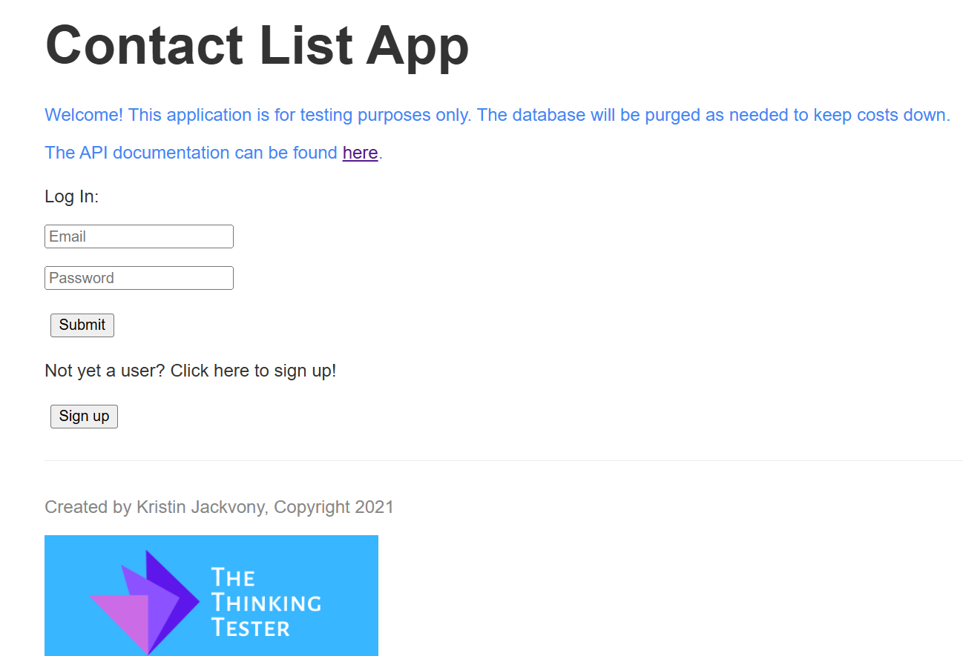
Project Overview
The application allows users to manage their contacts efficiently, including adding, editing,deleting, and searching for contacts.
In this project, we performed API testing on the Users and Contacts APIs to ensure their functionality, reliability, and security.
Notes:
dina

Slide 3
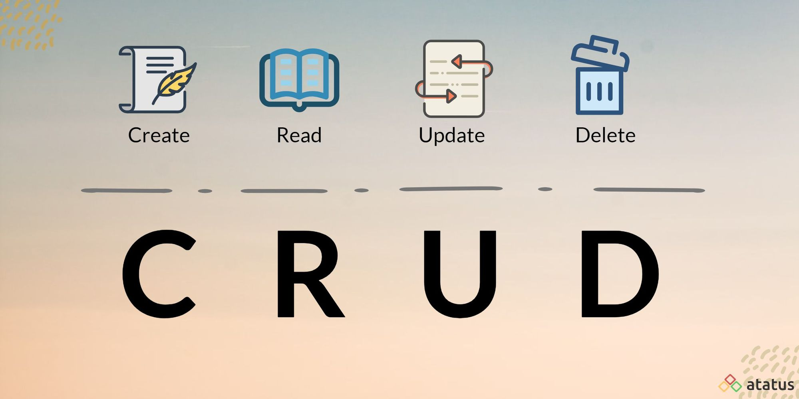
CRUD refers to the four basic operations used to manage resources in an API:
Create: Add new data (e.g., POST request)
Read: Retrieve existing data (e.g., GET request)
Update: Modify existing data (e.g., PUT or PATCH request)
Delete: Remove data (e.g., DELETE request)
These operations ensure efficient interaction with the API to manage and manipulate data.
CRUD Operations in API
Notes:
dina

Slide 4
Scope of Testing
Users API Testing
We tested the following key functionalities:
User Registration & Login – Ensuring authentication works correctly.
User Data Retrieval – Checking if user profiles are fetched properly.
User Updates & Deletion – Validating modifications and account deletion.
Contacts API Testing
For the Contacts API, we verified:
Adding New Contacts – Ensuring correct data storage.
Editing & Deleting Contacts – Confirming changes reflect accurately.
Fetching Contacts – Testing search and filtering options.
Notes:
mark

Slide 5
Testing Approach
API Testing
Valid and Invalid Test Cases
Authentication Checks
CRUD Operations on Contacts
UI Testing
UI Functionality & Responsiveness
Form Validation & Error Handling
Navigation & User Experience
Notes:
mark

Slide 6
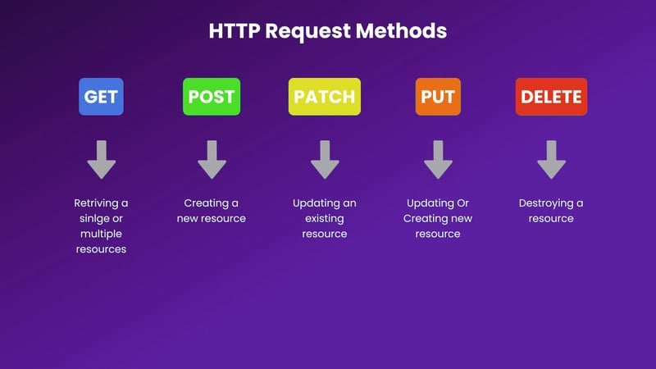
API Triggers and UI Interactions
API Endpoints Triggered by UI Actions
User Actions:
Register → POST /users
Login → POST /users/login
Logout → POST /users/logout
Contacts Management:
Retrieve Contacts → GET /contacts
Add Contact → POST /contacts
Edit Contact → PUT /contacts/{id}
Delete Contact → DELETE /contacts/{id}
Notes:
dina

Slide 7
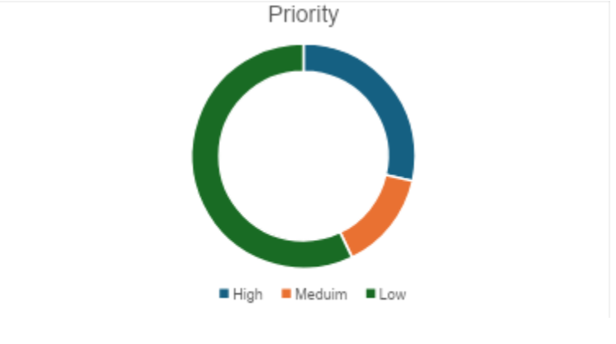
Defect Distribution
High Priority: 4
Medium Priority: 2
Low Priority: 8
Test Case Priority Distribution categorizes test cases based on their urgency for execution. It helps prioritize testing efforts by assigning levels such as high, medium, and low priority, teams can focus on the most critical areas of the application first.
Notes:
mark

Slide 8
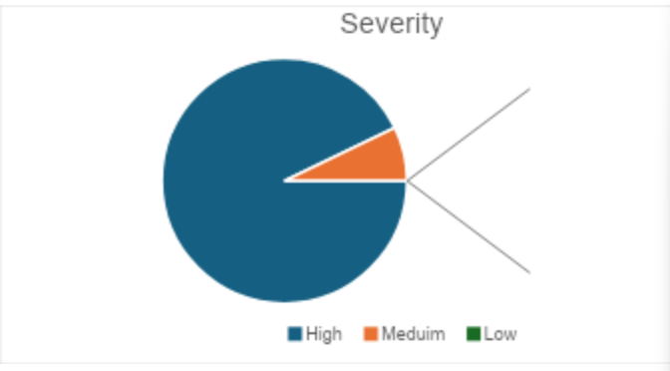
Defect Distribution
High Severity: 13
Medium Severity: 1
Low Severity: 0
Test Case Severity Distribution categorizes test cases based on the impact of a defect if it fails. It helps assess how critical an issue is, with levels ranging from critical to low severity.
Notes:
mark

Slide 9
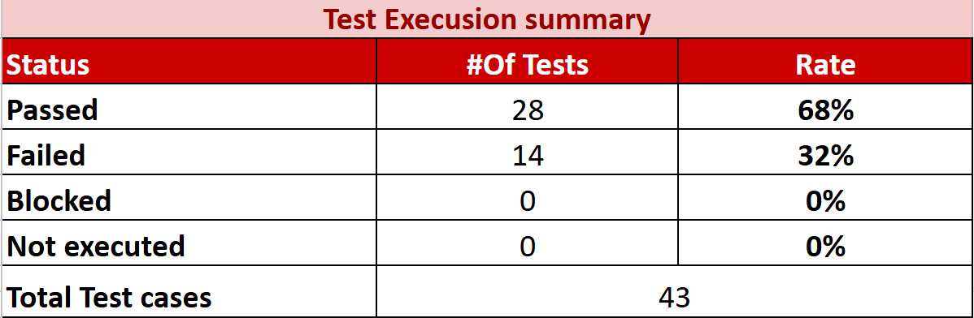
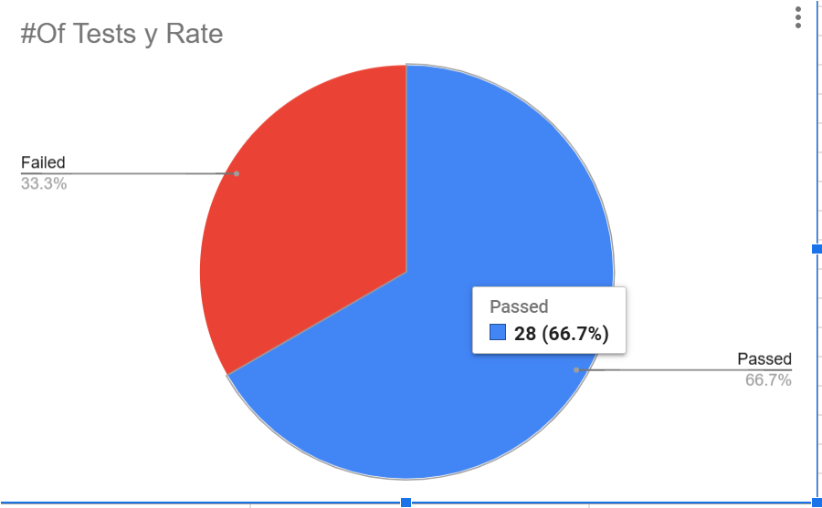
Test Execution Summary
Notes:
dina

Slide 10
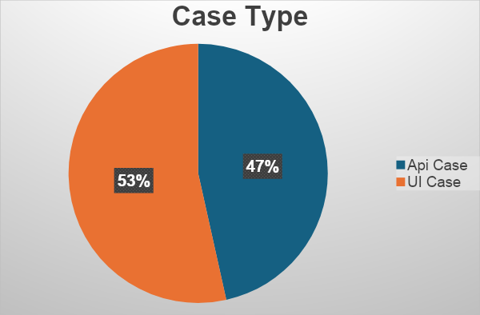
Test Case Distribution by Type
API Test Cases: 20
UI Test Cases: 23
Notes:
dina

Slide 11
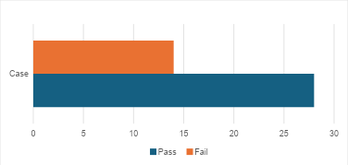
Test Case Status Overview
Passed: 28
Failed: 14
Notes:
dina

Slide 12
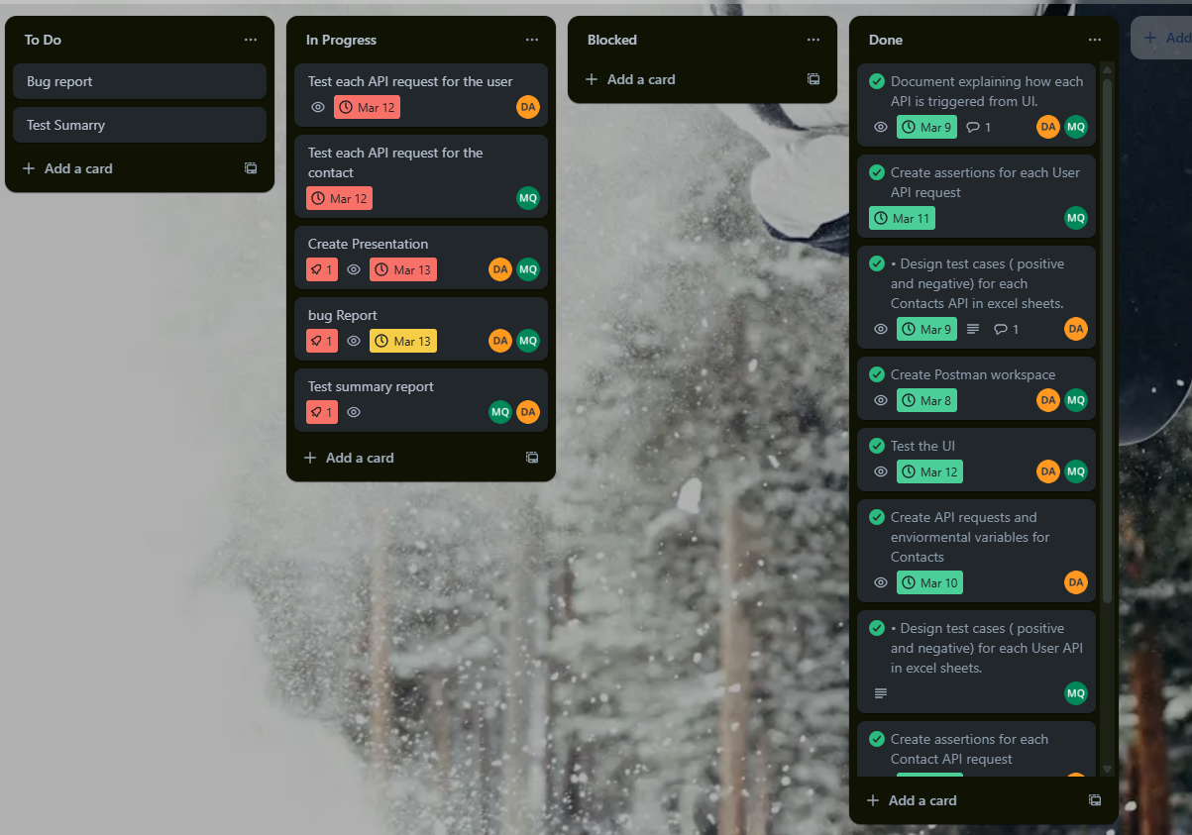
Team Collaboration and Tools
We worked closely together through daily stand-ups and weekly meetings, ensuring constant communication. Trello was used to assign tasks and monitor progress, while Excel/Google Sheets managed Test Case Design ,Postman managed the API testing approach .Regular updates and clear communication enhanced our workflow, leading to the successful completion of the project.
Notes:
mark

Slide 13
Challenges and Solutions
Limited experience with API testing led to minor difficulties in understanding request/response formats and troubleshooting errors.
Challenges | Solution
Lack of Experience with API Testing | We researched API testing best practices and reviewed previous examples and assignments to deepen our understanding.
Notes:
mark

Slide 14
Conclusion
In conclusion, API testing played a crucial role in ensuring the Contact List Application functioned smoothly and efficiently. By thoroughly testing the Users API and Contacts API, we validated key features such as user registration, login, contact creation, editing, and deletion. This helped identify and resolve critical issues early, ensuring data integrity and security. Overall, API testing ensured that the backend processes were reliable, enabling a seamless experience for users interacting with the app.
Notes:
mark

